Slide 1
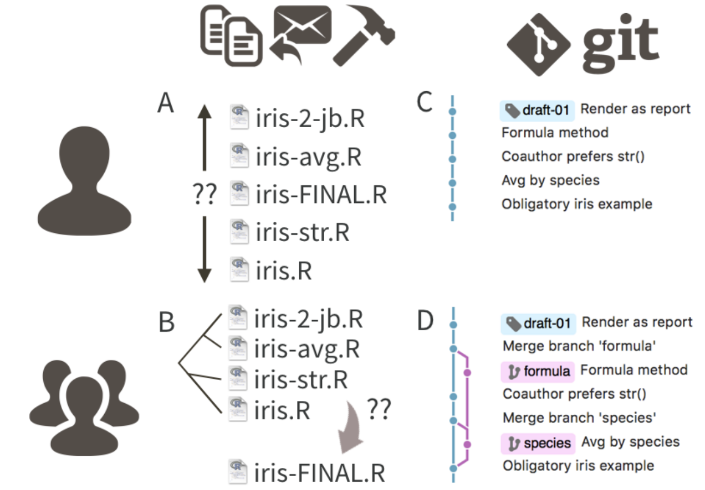
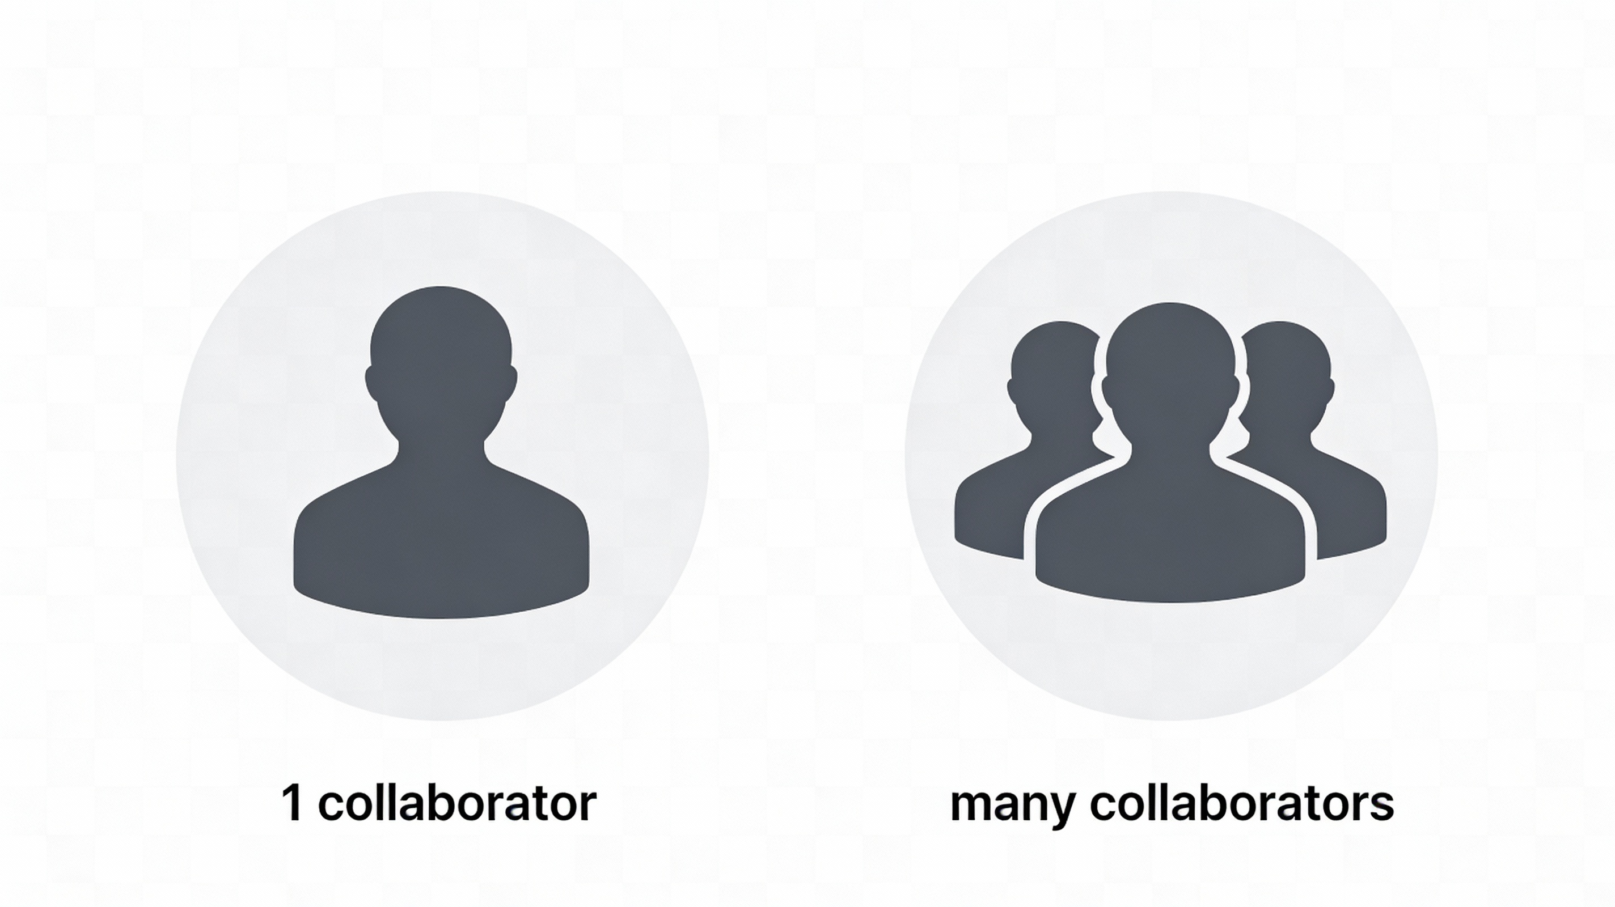

Slide 2


Slide 3




Slide 4




Slide 5




Slide 6
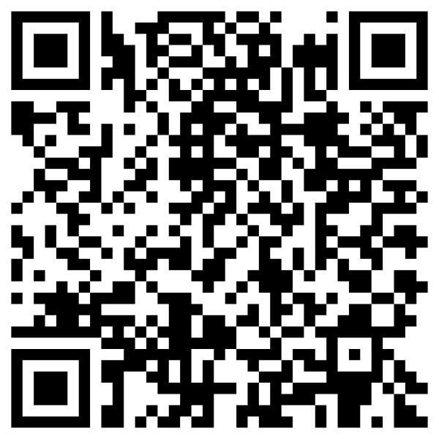

https://seredef.github.io/Github_course_final_final_v3_REALLYTHISONE/slides.html

Slide 7
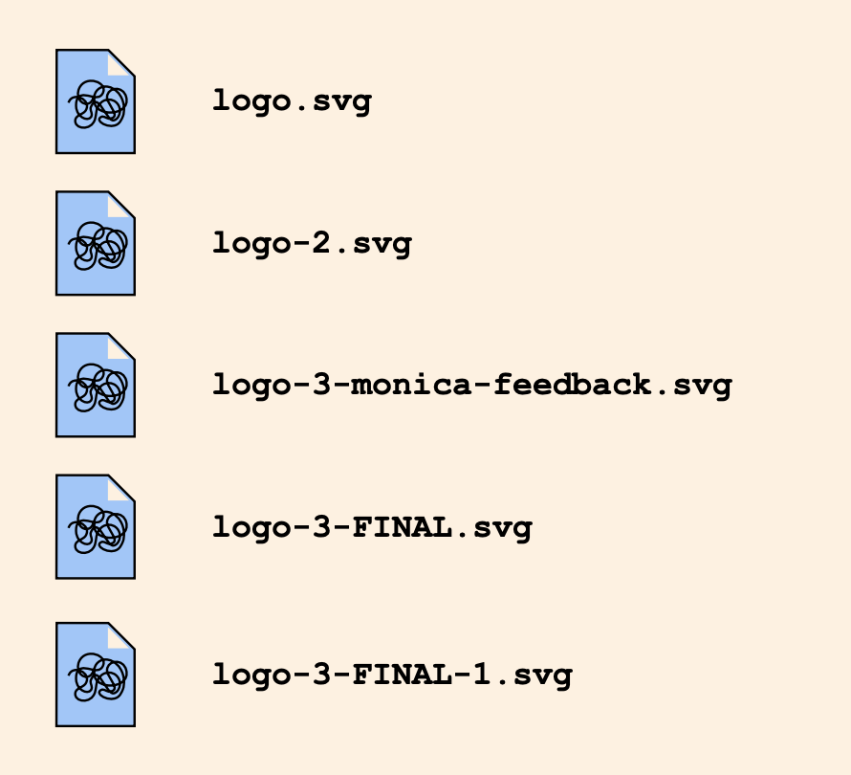
commit
commit
“Monica’s suggestion”

Slide 8
17-12-2025: deleted typo
377dfcd00dd057542b112cf13be6cf1380b

Slide 9
wild-experiment
main
better-analyses

Slide 10
wild-experiment
main
main
better-analyses

Slide 11


remote
me
not-me

Slide 12
remote
clone
me
clone
not-me

Slide 13
remote
me
Fixed a bug
not-me

Slide 14
remote
me
push
not-me

Slide 15
remote
pull
me
not-me

